Slide 1
(NAAC Accredited ‘A+’ Grade Institute & Approved U/s 2(f) of UGC Act 1956
LINGAYA’S LALITA DEVI INSTITUTE OF MANAGEMENT & SCIENCES
Mandi Road, Mandi, New Delhi-110047, Ph: (+9111-43791939), Fax: 011-26651050
Affiliated to GGSIP University, Delhi, Govt. of Delhi & NCTE
(NAAC “A+” Grade ^{Accredited)}
NEWSLETTER: APRIL, 2025
DEPARTMENT: EDUCATION
^{THEME:} “Skill Development”
Process of acquiring, improving, and enhancing a wide range of skills and competencies.
Deliberate, continuous effort to build knowledge, expertise, and capabilities in specific areas to meet the demands of one's work or to pursue personal and professional growth.
Development of skills contribute to structural transformation
economic growth by enhancing employability and labor productivity and
helping countries to become more competitive.

Slide 2
ACTIVITIES CALENDAR
01.04.2025* | 02.04.2025* | 03.04.2025* | 04.04.2025* | 05.04.2025*
06.04.2025* | 07.04.2025* | 08.04.2025* | 09.04.2025* JOB FAIR | 10.04.2025*
11.04.2025* | 12.04.2025* | 13.04.2025 | 14.04.2025* | 15.04.2025*
16.04.2025 | 17.04.2025 | 18.04.2025 WORKSHOP ON MICRO TEACHING SKILLS | 19.04.2025 WORKSHOP ON MICRO TEACHING SKILLS | 20.04.2025
21.04.2025 VISIT TO INCLUSIVE SCHOOL -ANANT LEARNING CENTRE | 22.04.2025 | 23.04.2025 | 24.04.2025 | 25.04.2025 AWARENESS ON ROLE OF GUIDANCE FOR ACADEMIC PURPOSES
26.04.2025 | 27.04.2025 | 28.04.2025 | 29.04.2025 | 30.04.2025 ENGAGING STUDENTS IN SELF ASSESMENT TECHNIQUES
ACTIVITIES ARE FLERXIBLE ,THE DATES CAN BE CHANGED.
*PSE II :1ST TO 15TH APRIL 2025

Slide 3
SYLLABUS TO BE COVERED IN APRIL
BED102- Learning and Teaching Syllabus Unit – IV & PRESENTATION | BED210- Gender, School and Society Syllabus Unit – IV & PRESENTATION | Subject: BED222 Health and Physical Education Syllabus Unit – IV & PRESENTATION
BED210- Gender, School and Society Syllabus Unit – IV & PRESENTATION | Subject: BED 212- Knowledge and Curriculum: Perspectives in Education Syllabus Unit – IV & PRESENTATION | Subject: BED232- Life Skills Education Syllabus Unit – IV & PRESENTATION
Subject: BED104- Contemporary perspectives in Education Syllabus Unit – IV & PRESENTATION | Subject: BED214- Guidance & Counselling Syllabus Unit – IV & PRESENTATION
Subject: BED110- Entrepreneurial Mindset Syllabus Unit – IV & PRESENTATION | Subject: BED216- Environmental Education Syllabus Unit – IV & PRESENTATION
Subject: BED116- 150- Pedagogy of School Subject-(I) Pedagogy of School Subject-(II) Syllabus Unit – IV & PRESENTATION | Subject: BED218- Creating an Inclusive School Syllabus Unit – IV & PRESENTATION

Slide 4
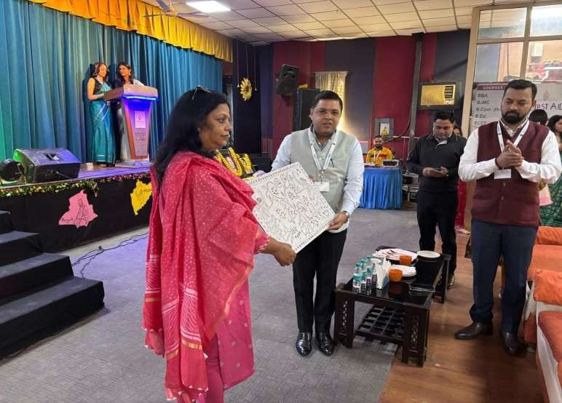
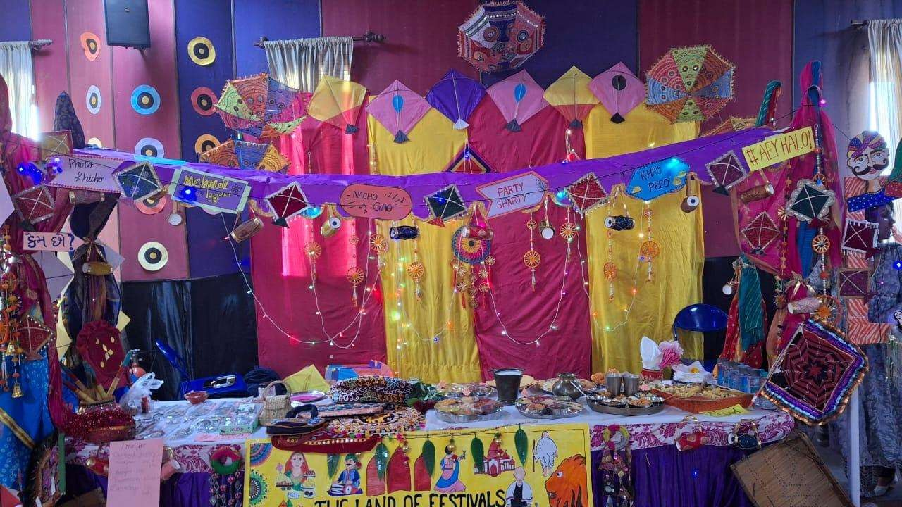
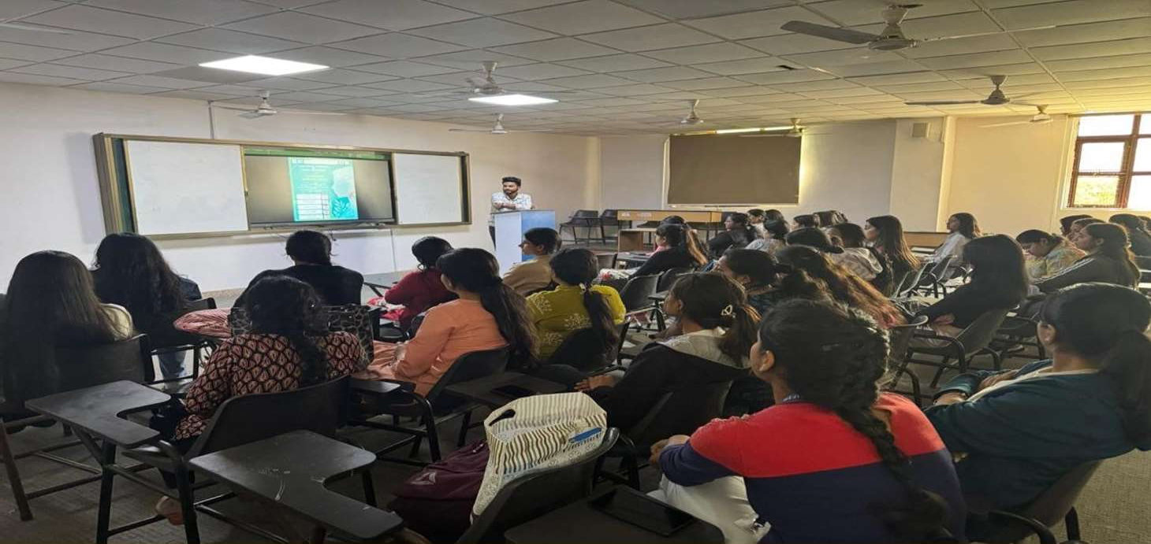
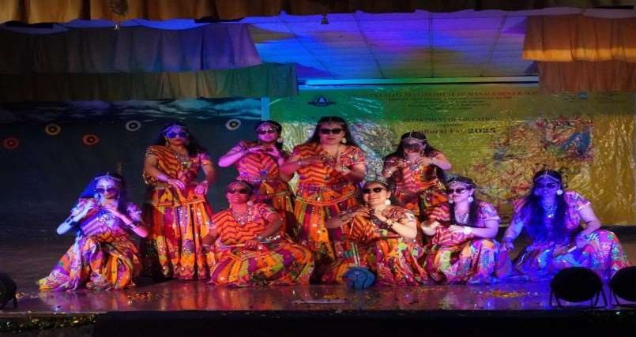
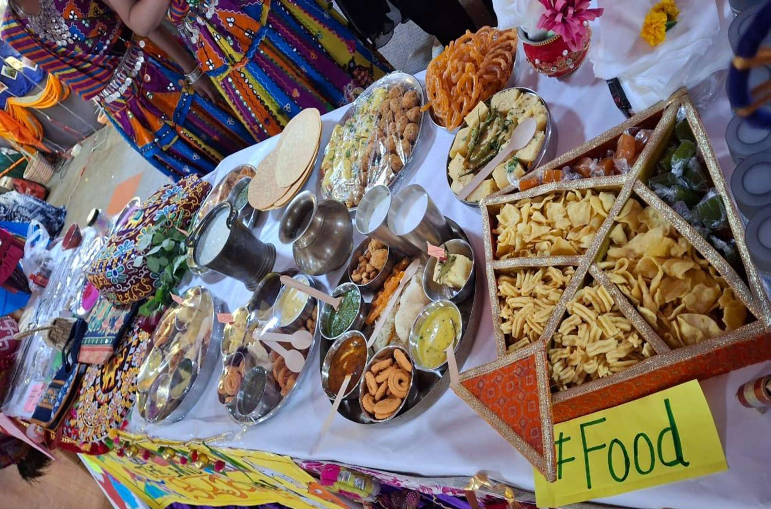
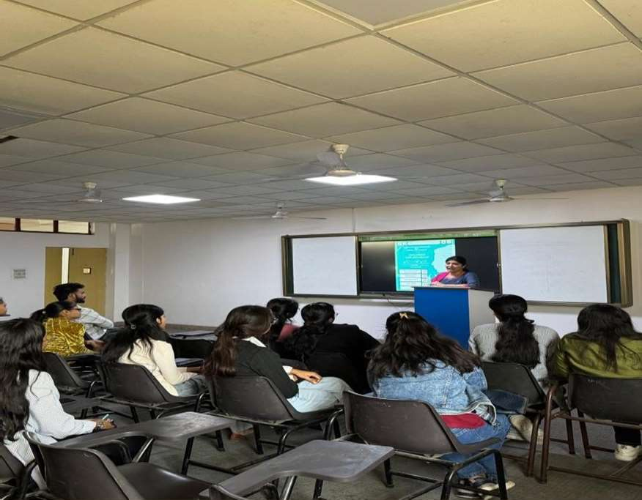
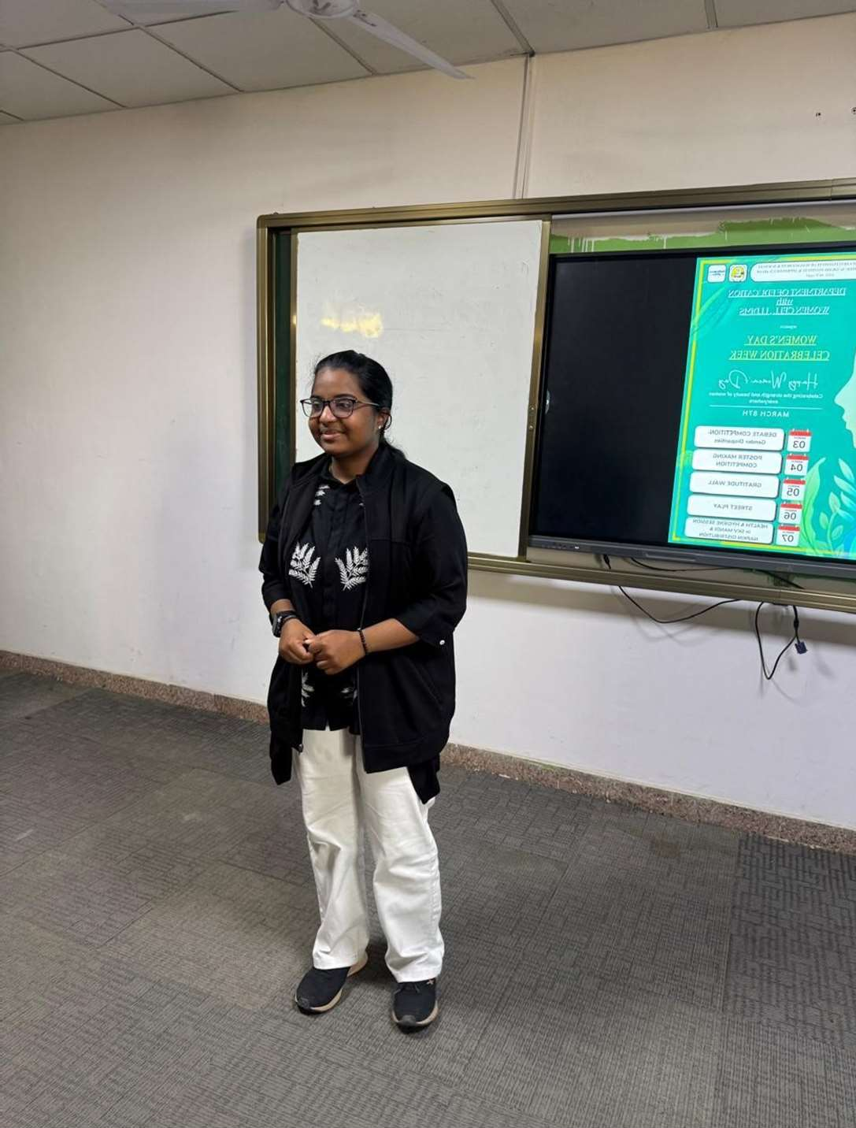
GLIMPSES OF CELEBRATION DONE IN THE MONTH OF MARCH 2025
CULTURAL FAIR
DEBATE COMPETITION

Slide 5
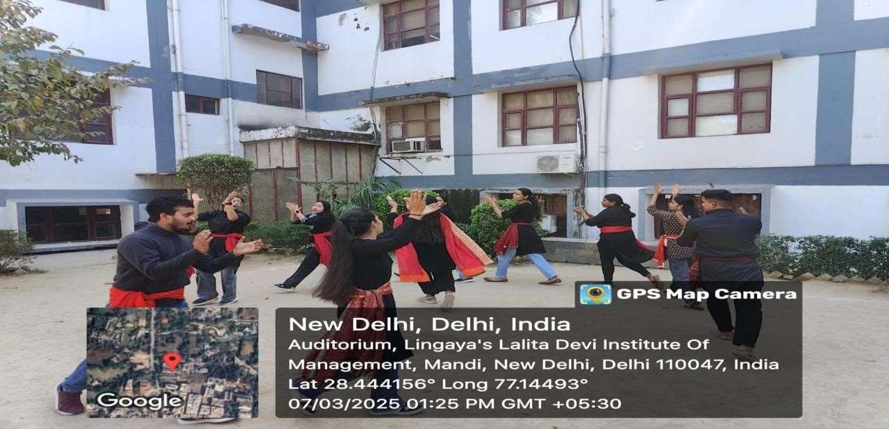
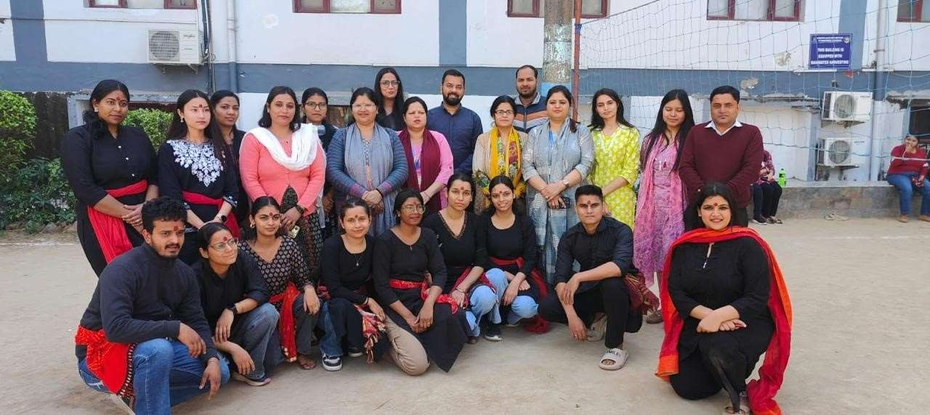
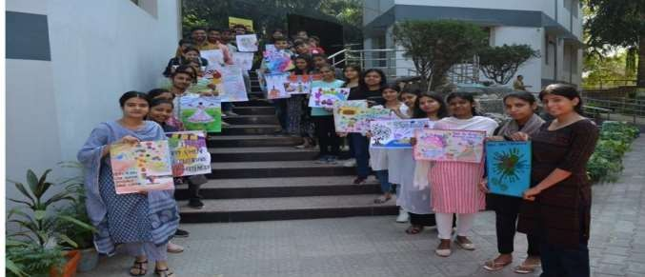
STREET PLAY
POSTER MAKING

Slide 6
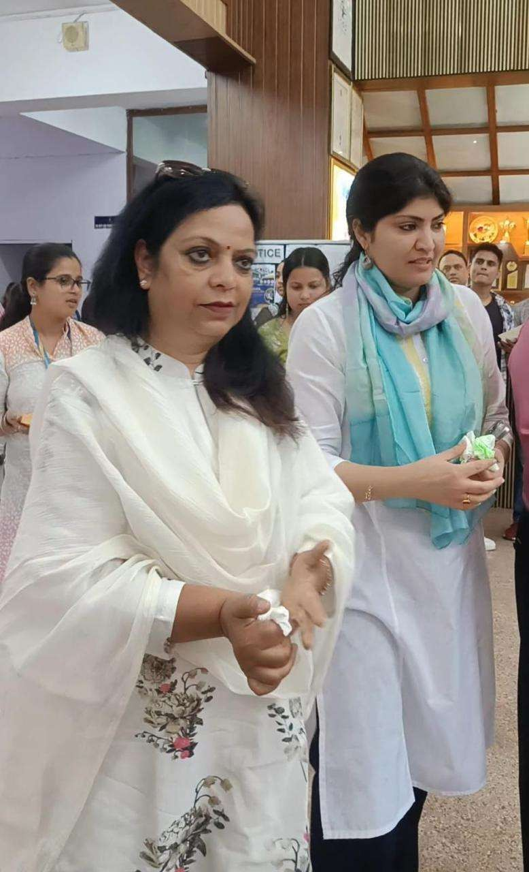
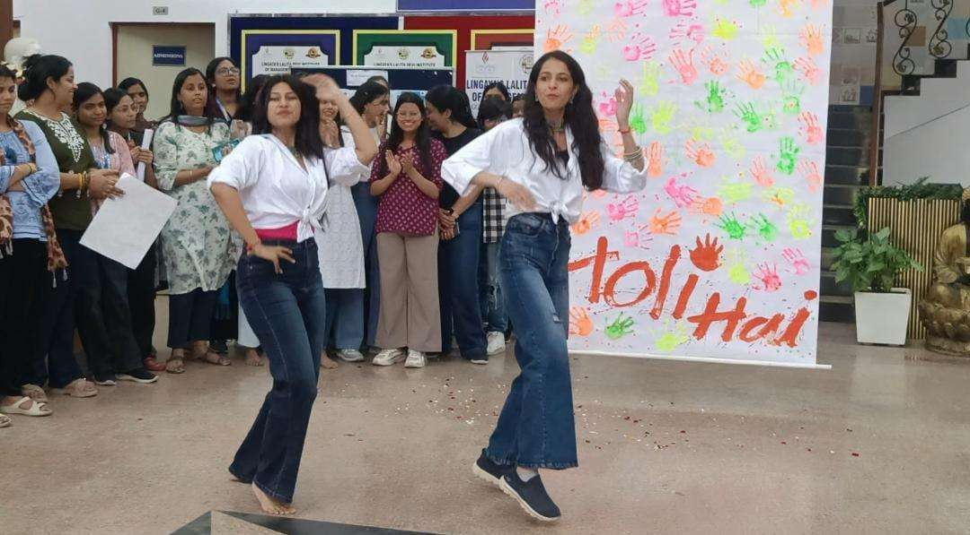
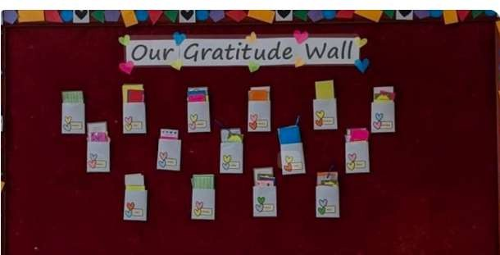
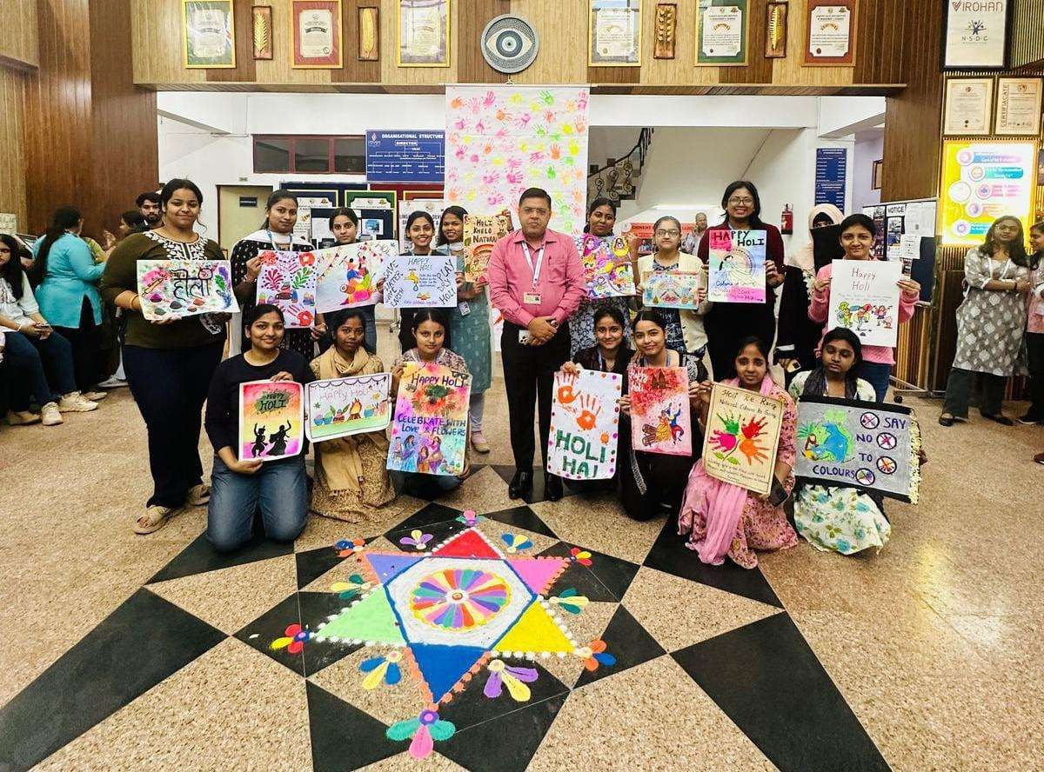
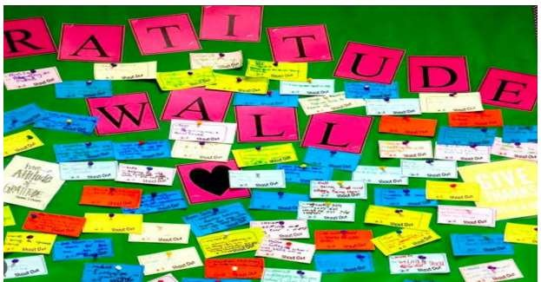
HOLI CELEBRATION
GRATITUDE WALL

Slide 7
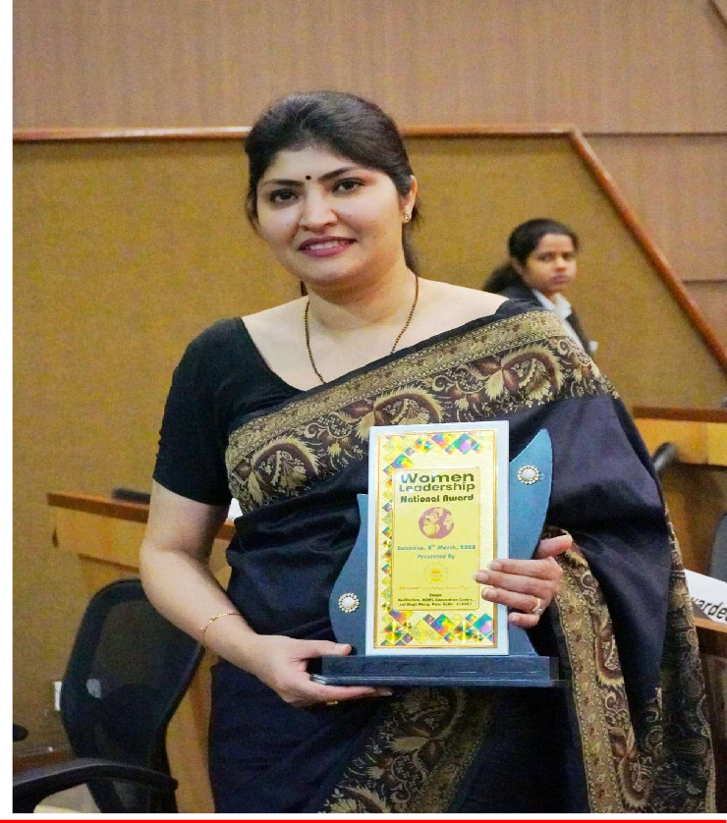
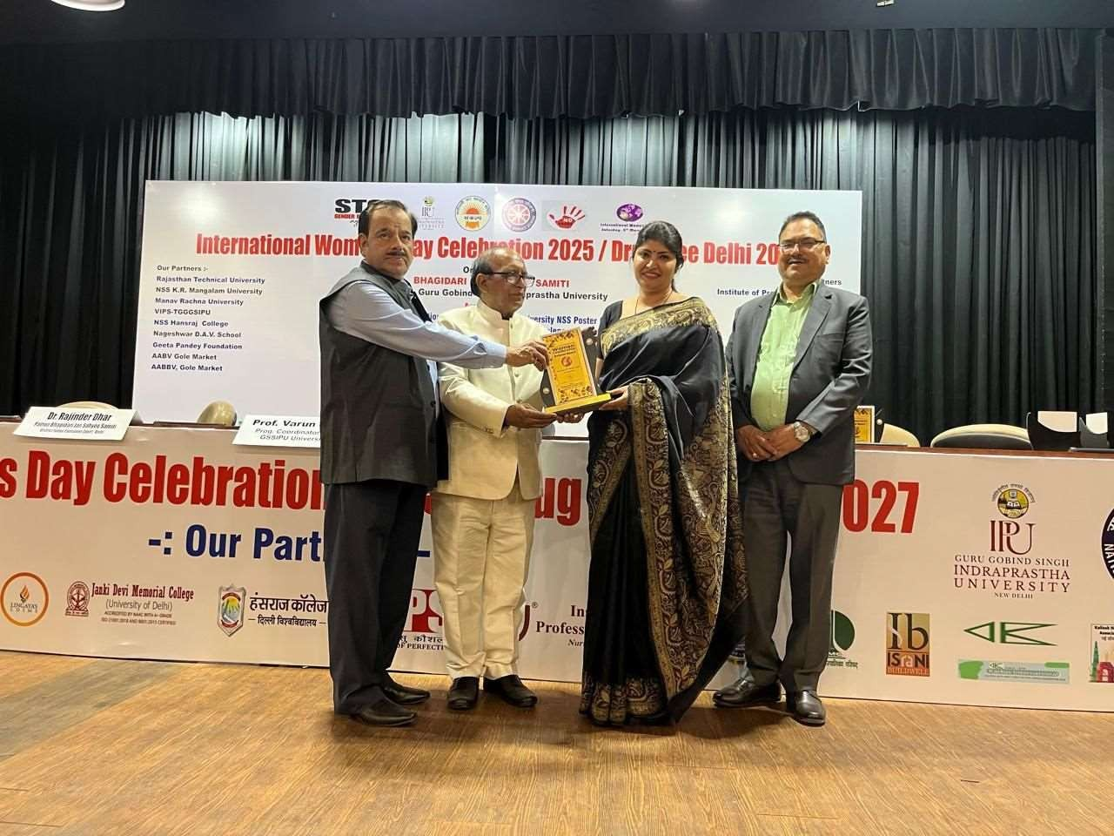
AWARDS & RECOGNITIONS
WOMEN’S LEADERSHIP AWARD

Slide 8
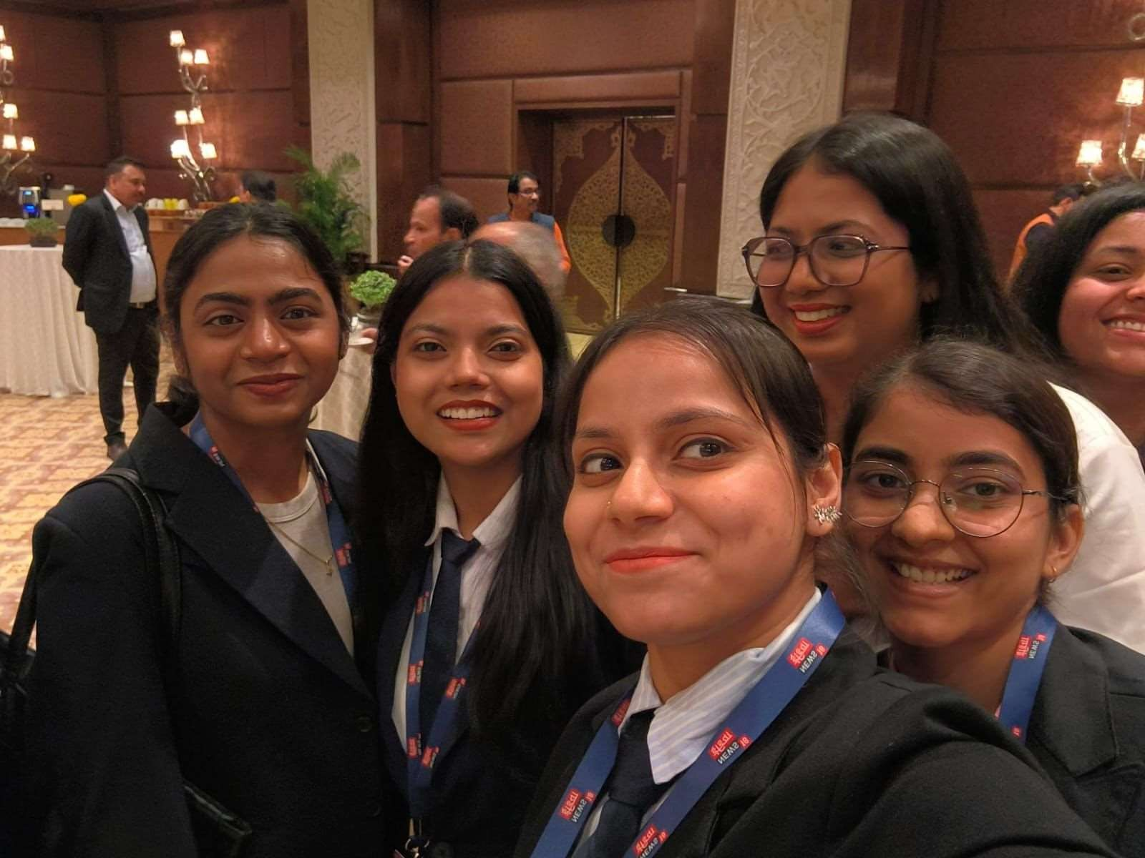
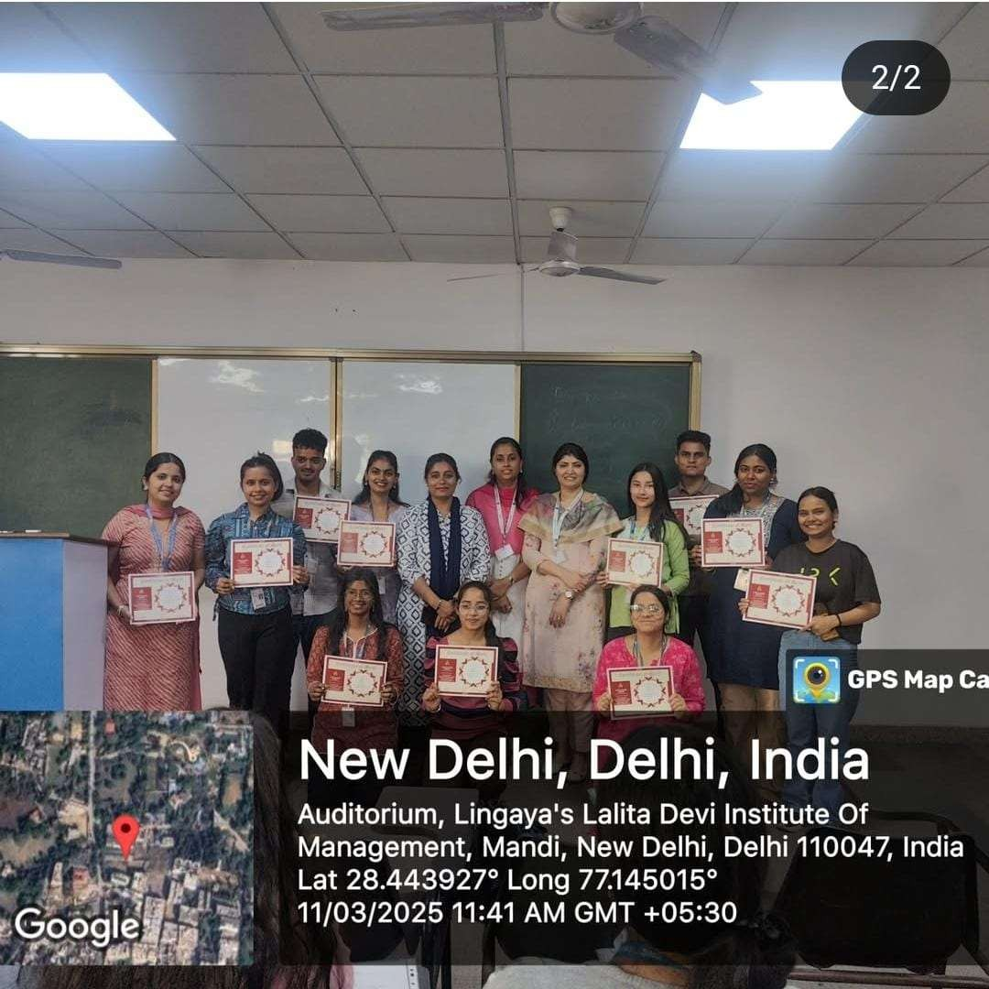
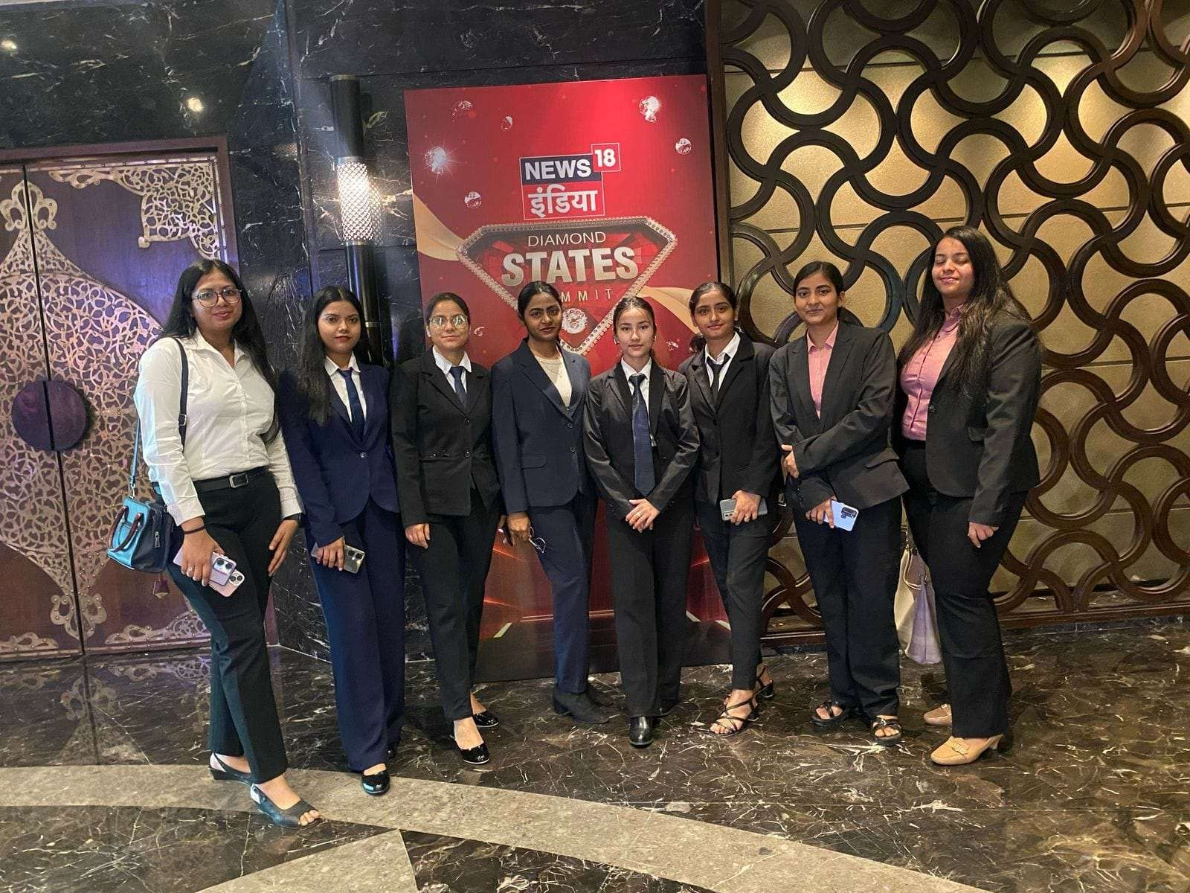
AWARDS & RECOGNITIONS
DISTRIBUTION OF CERTIFICATES OF STREET PLAY
TAJ EVENT

Slide 9
K12 CAMPUS PLACEMENT DRIVE ACHIEVERS

Slide 10
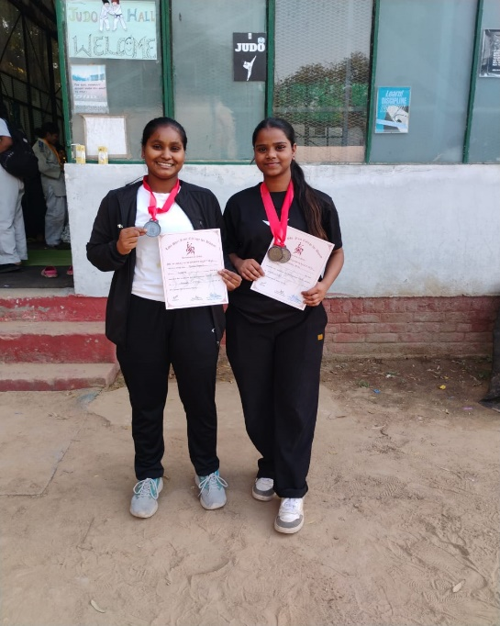
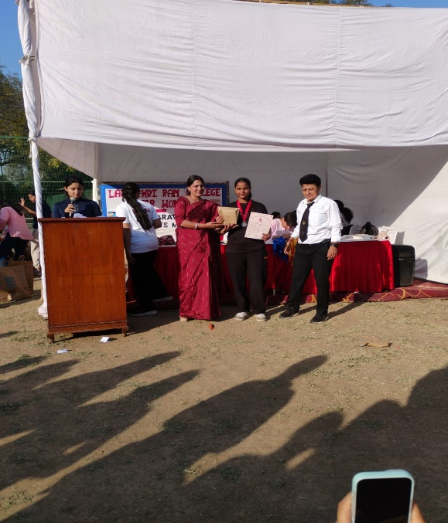
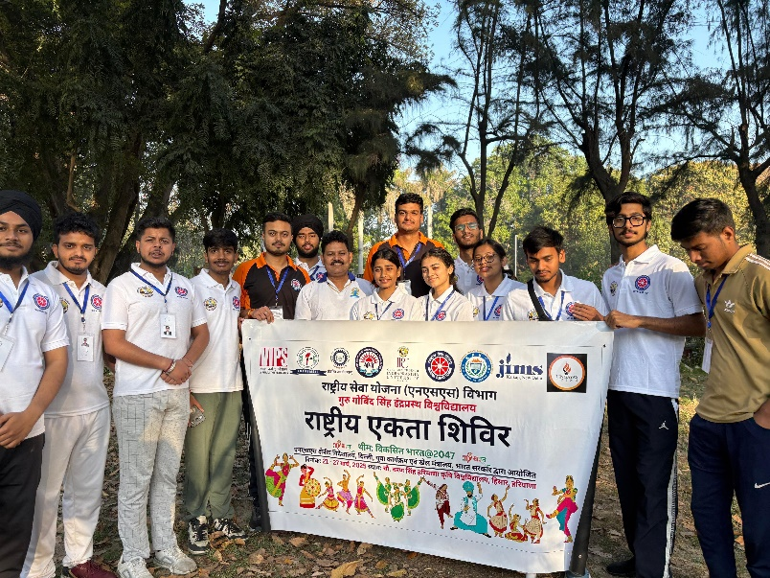
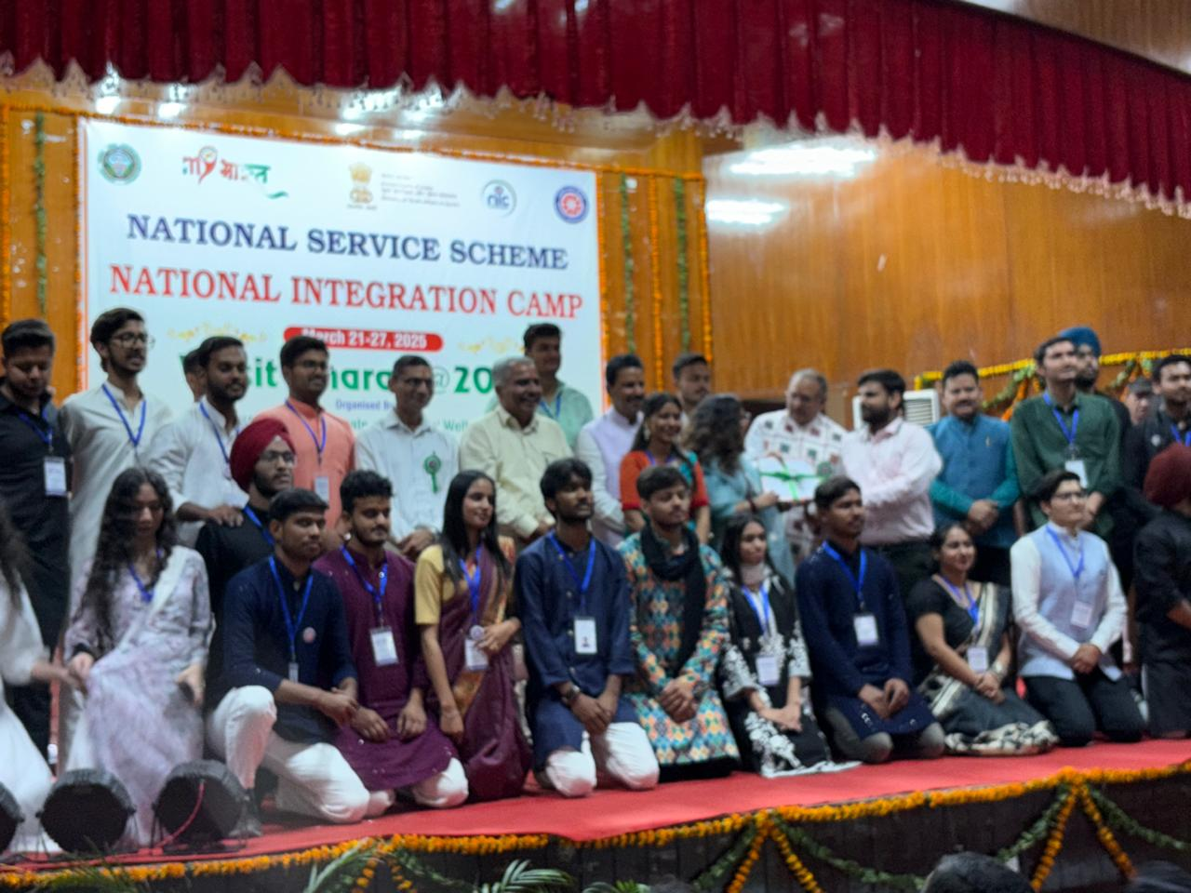
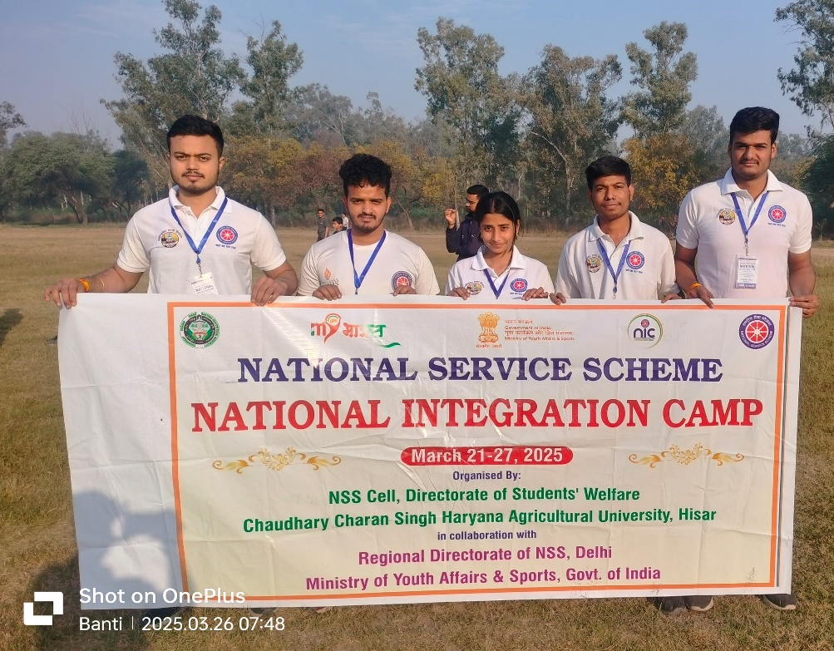
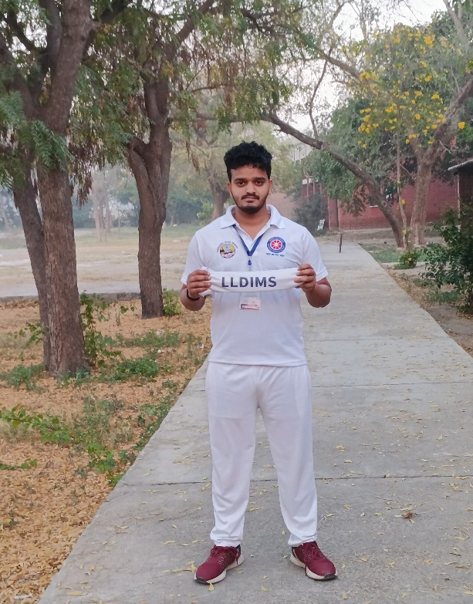
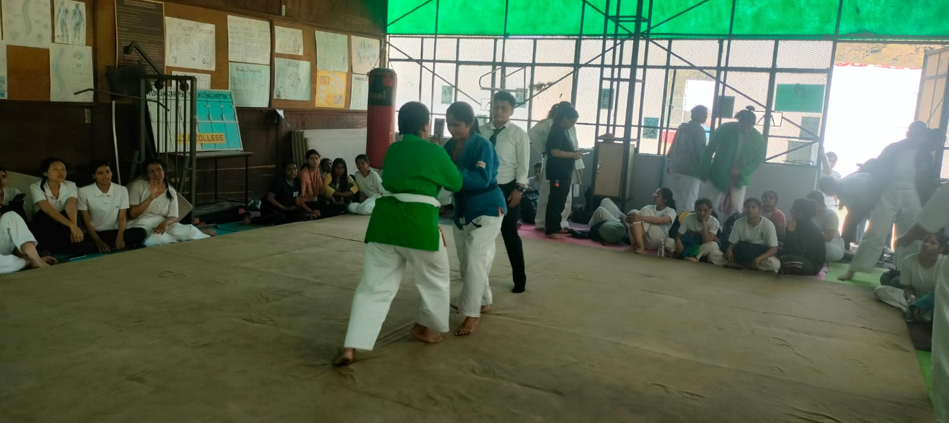
AWARDS & RECOGNITIONS
JUDO COMPETITION
NSS EVENT

Slide 11
FOLLOW US ON
https://www.linkedin.com/company/lldims-delhi/
https://www.instagram.com/doe_lldims/
https://www.youtube.com/@lingayasldims
ABOUT US: https://lldims.edu.in/CONTACT NO - +91-11-437919
FACULTY MEMBERS: Dr. Jyoti Dahiya ,HoD (Department of Education) Prof. Dr. Manju Sharma , Ms. Anjali Bhardwaj, Mr. MasroorHasan , Ms. Neha Mohgaonkar, Ms . PrachyaPrerna, Dr.Bindia Rani, Ms.Baby kumari Mr. Anil, Mr. Rashid Ahmed
Ms.Baby kumari Newsletter Co-Ordinator
Dr. Jyoti Dahiya
HoD, Dept. of Education
Dr. Pranav Mishra Director, LLDIMS

